Slide 1
N4 RECOVERY
WEEK 5 REPORT
OBJECTIVES
TEST OF THE FLIGHT COMPUTER CIRCUITS
EJECTION CIRCUIT FOR PYRO TECHNIQUE
IMPROVE AND TEST STATE MACHINE TRANSITION CODE
IMPROVE ON THE FLOWCHART OF THE STATE MACHINE
FINALISE ON THE SPRING EJECTION MECHANISM
REDESIGN OF THE AVIONICS BAY
RESEARCH ON THE BLACK POWDER EJECTION TECHNIQUE

Slide 2
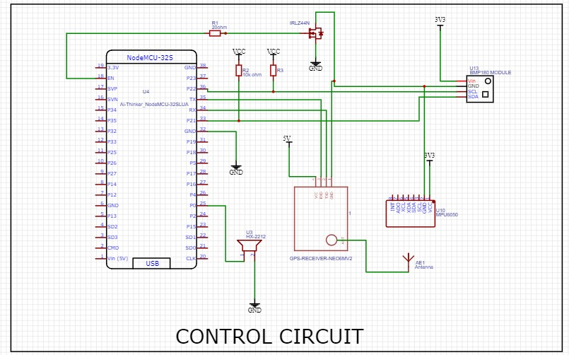
TEST OF FLIGHT COMPUTER
TESTED MPU, BMP, GPS AND ESP ACCORDING TO THE DESIGN CIRCUIT.

Slide 3
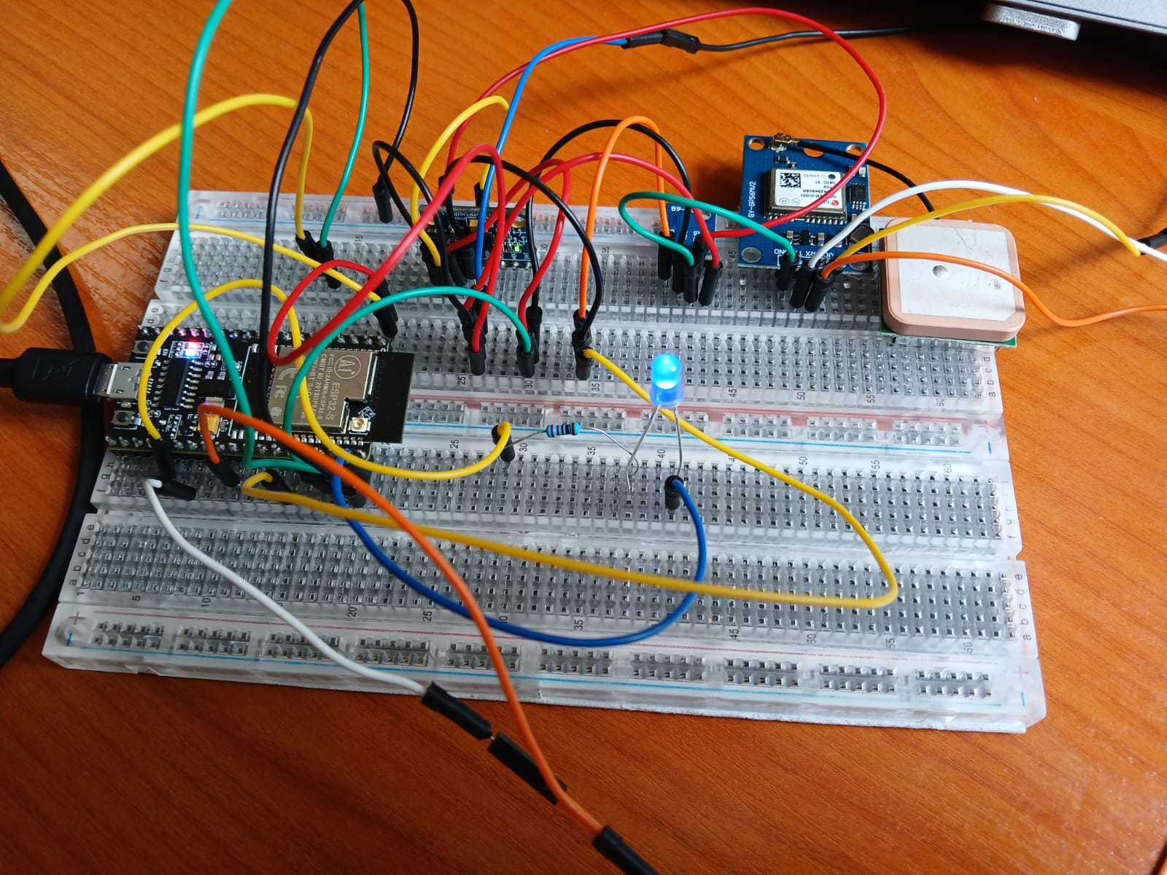
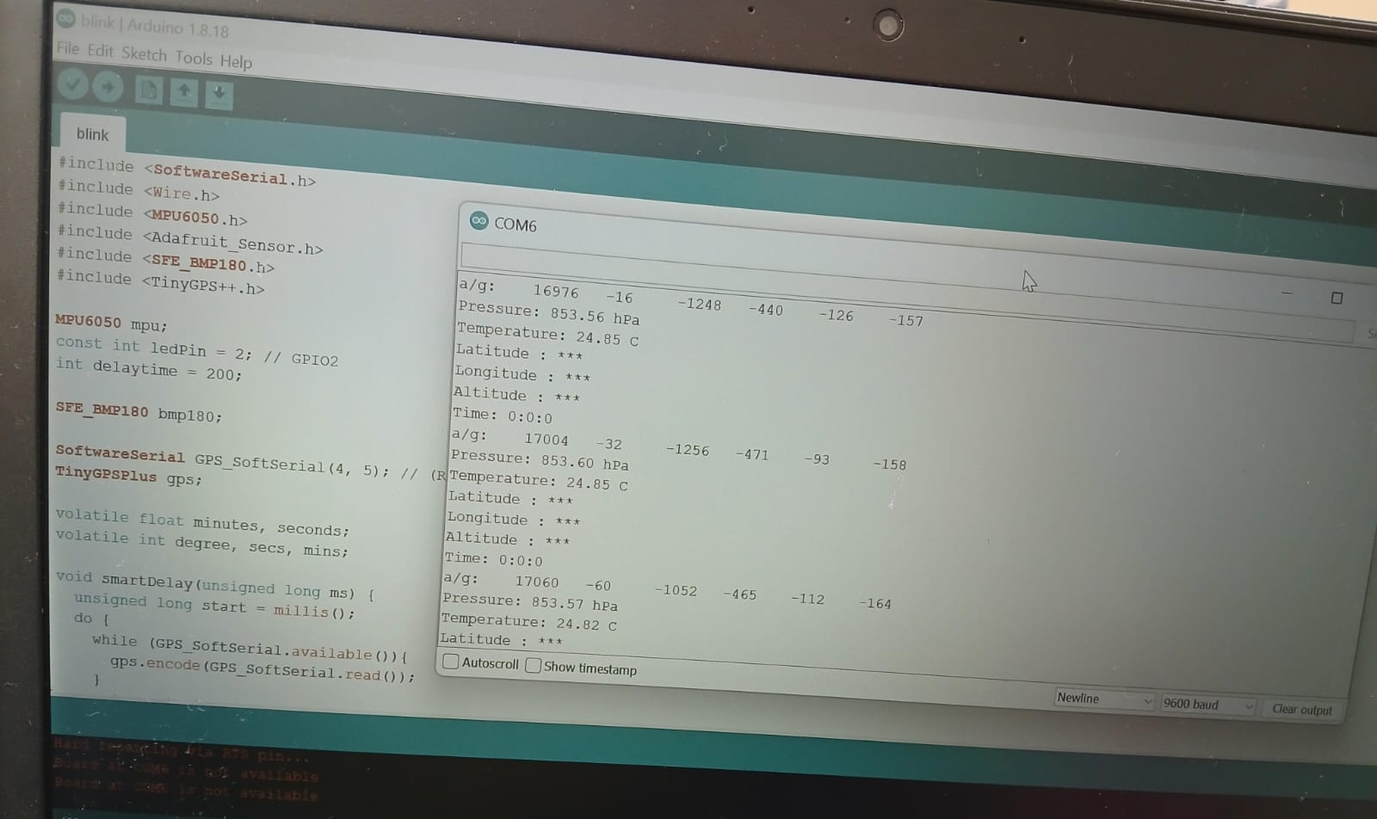

Slide 4

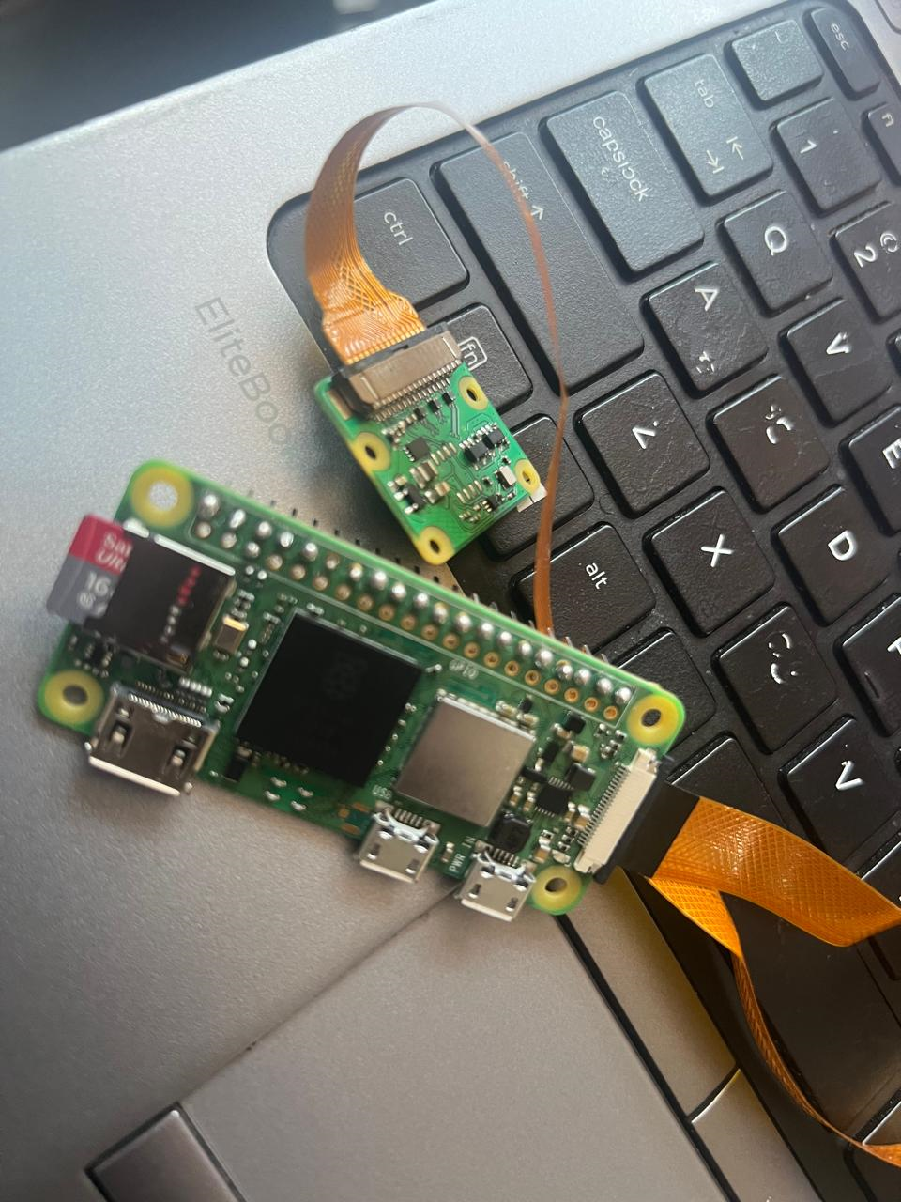
Camera module (Pi )
Fasten Lock Mechanism-
Silicone glue (sealant sparko )
Static ip and dynamic SSID configuration

Slide 5
TEST OF FLIGHT COMPUTER
TESTED MPU, BMP, GPS AND ESP ACCORDING TO THE DESIGN CIRCUIT.

Slide 6
Rocket attitude(orientation) calculations
We calculated the rocket's roll and pitch using the IMU data as seen in the following video
This will help in viewing the rocket's attitude during flight, and advising on rockets orientation in our state machine
https://youtu.be/2gBSyQe9rkE

Slide 7
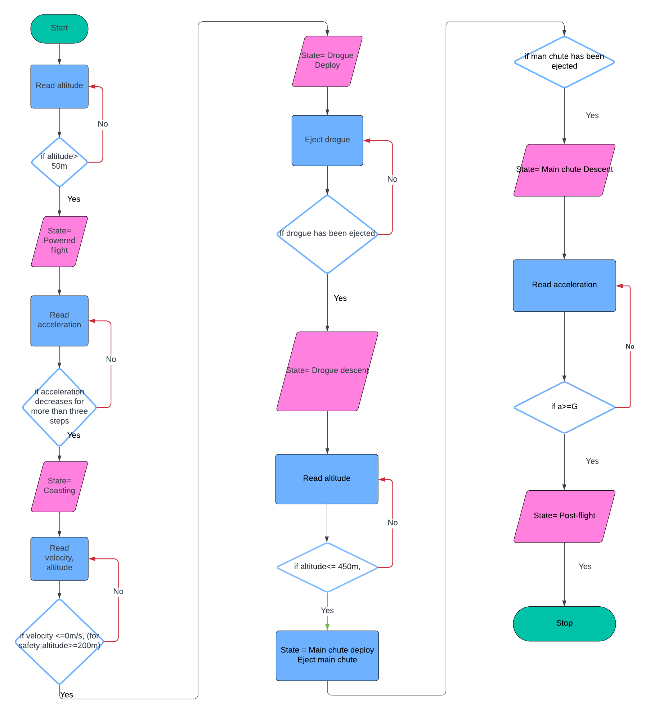
IMPROVED ON THE FLOWCHART OF THE STATE MACHINE

Slide 8
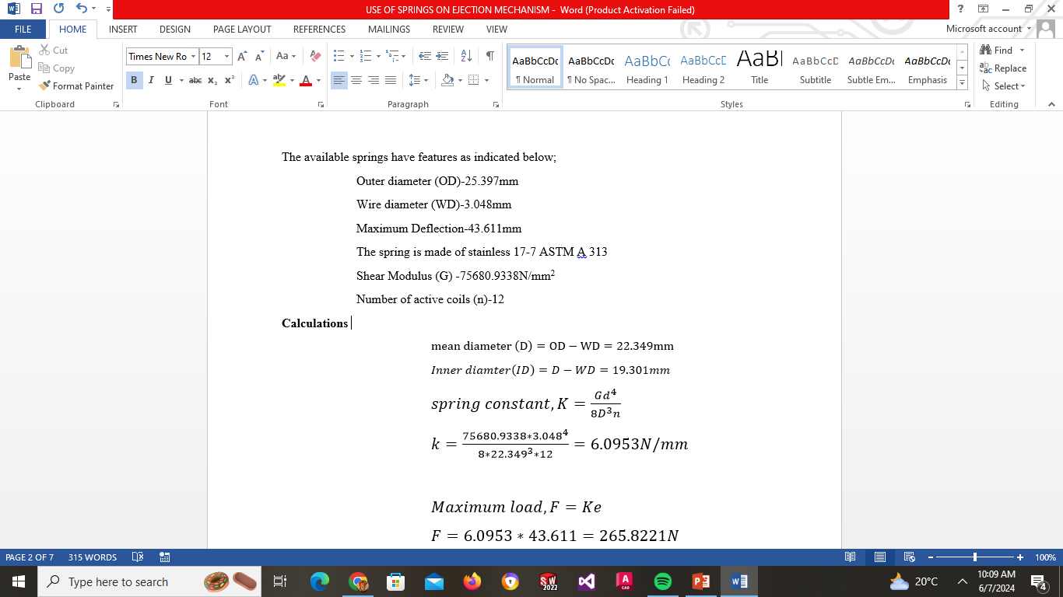
SPRING MECHANISM FINAL RESEARCH

Slide 9
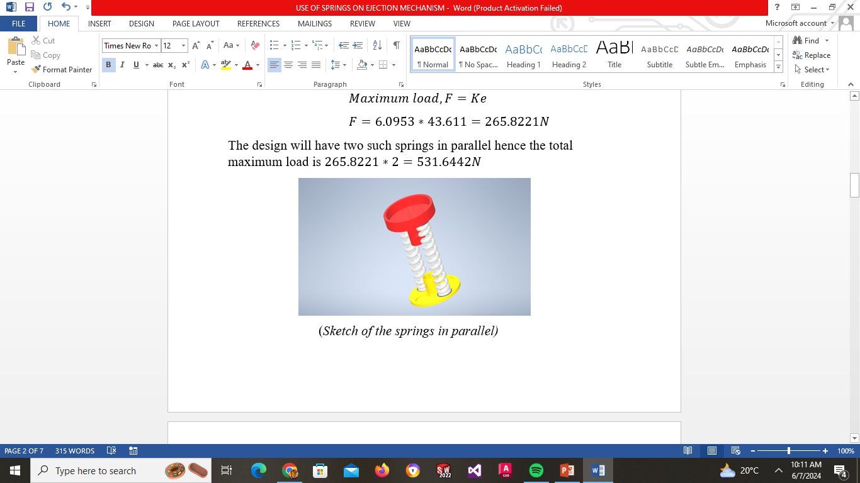

Slide 10
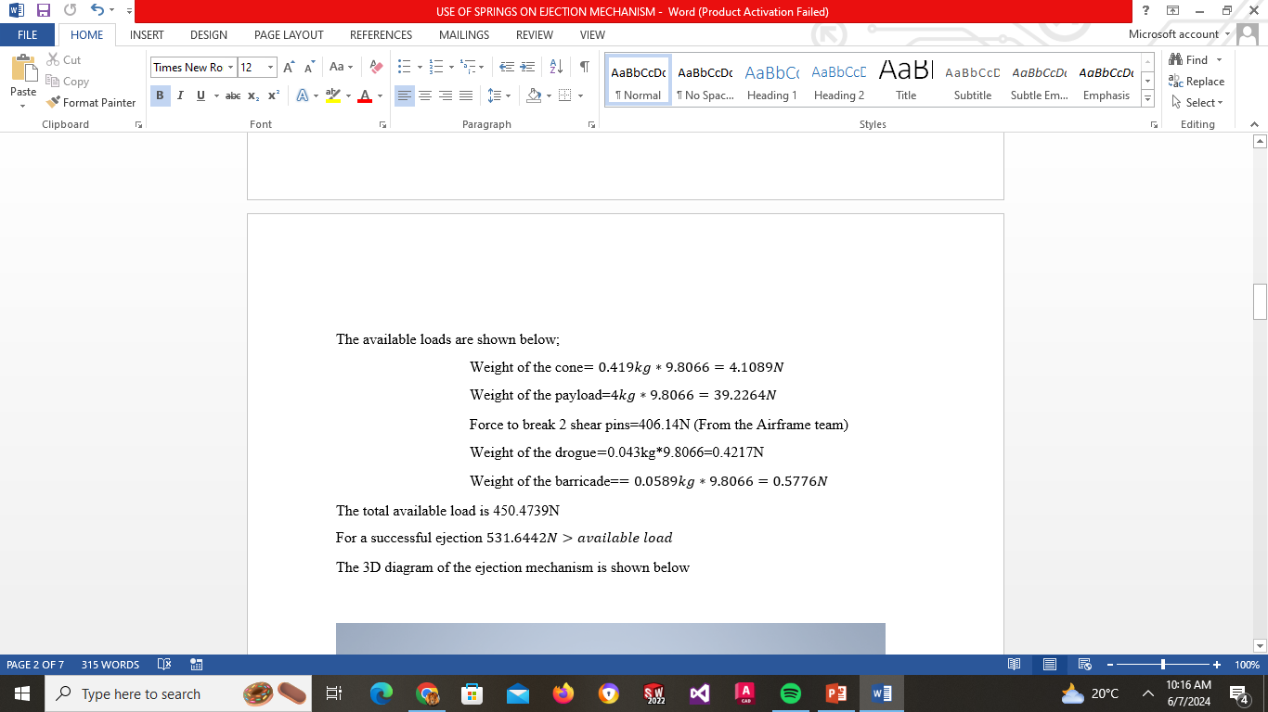
Strength of shear pins
https://1drv.ms/w/c/71d447d52d52c510/EVpe6vzDeV9Ajv4UG3dLVecBUfvCUEXYVl5CmYlWQuKeHQ

Slide 11
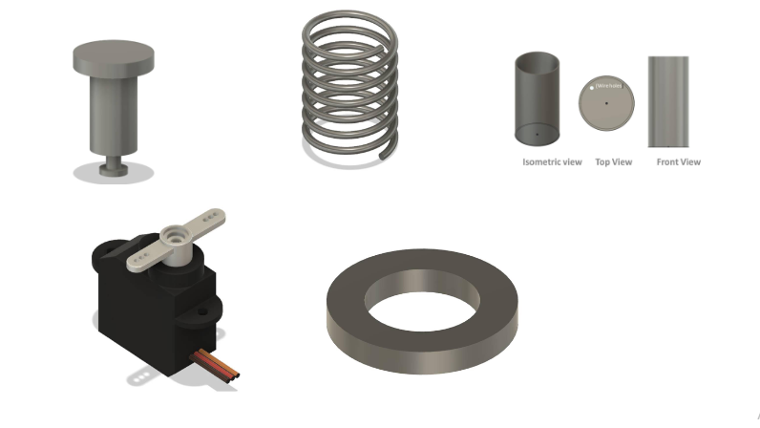
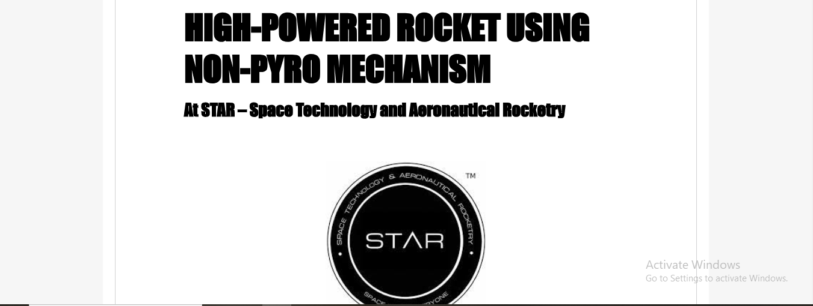
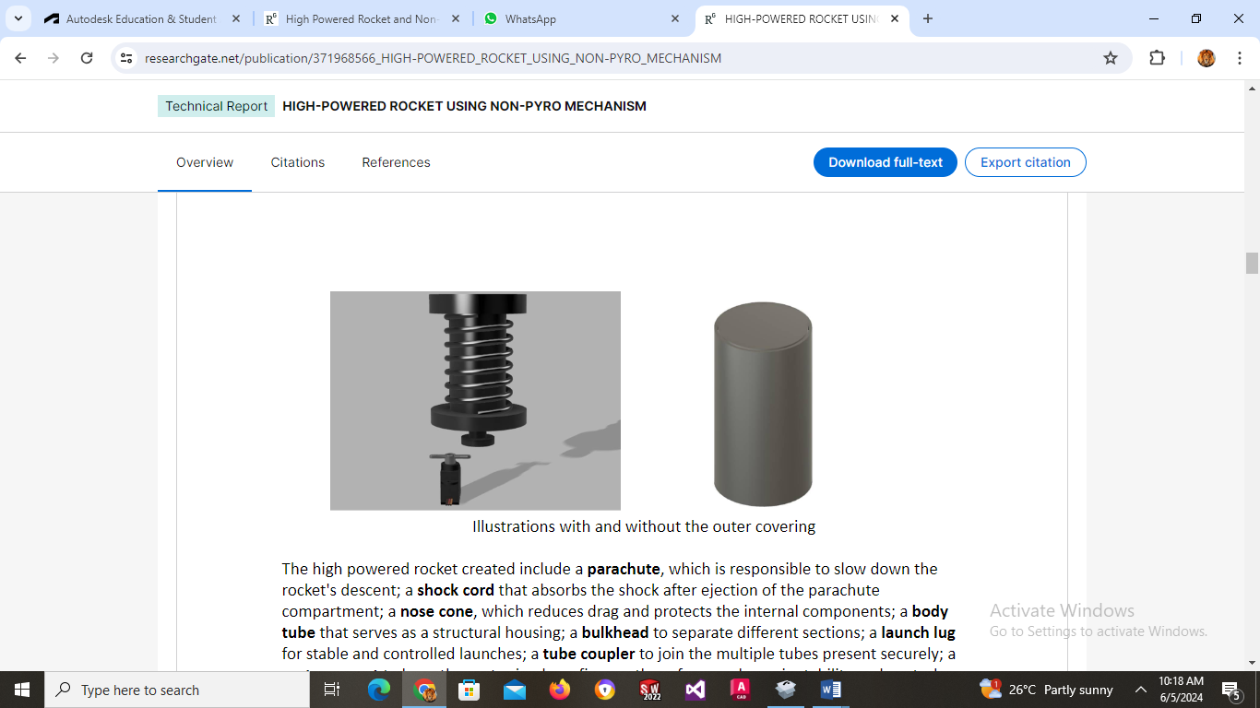
https://www.researchgate.net/publication/371968566_HIGH-POWERED_ROCKET_USING_NON-PYRO_MECHANISM

Slide 12
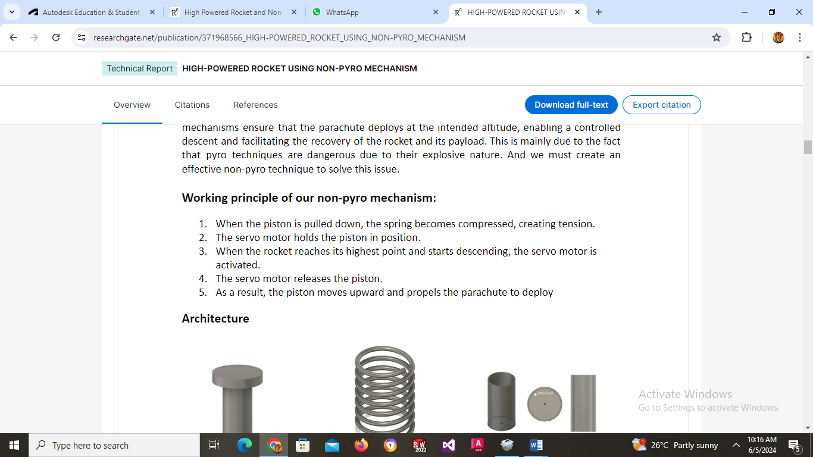

Slide 13
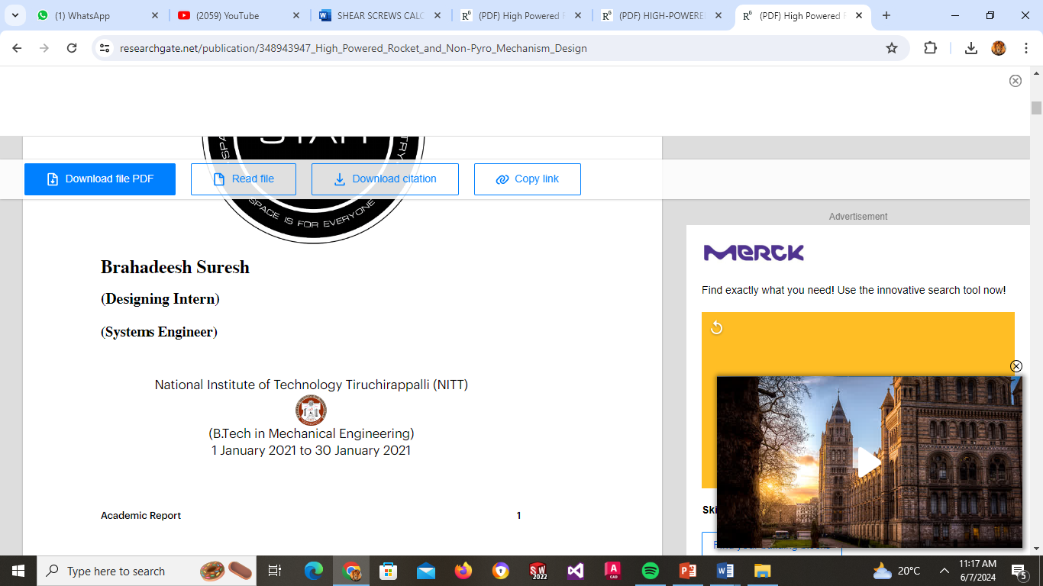
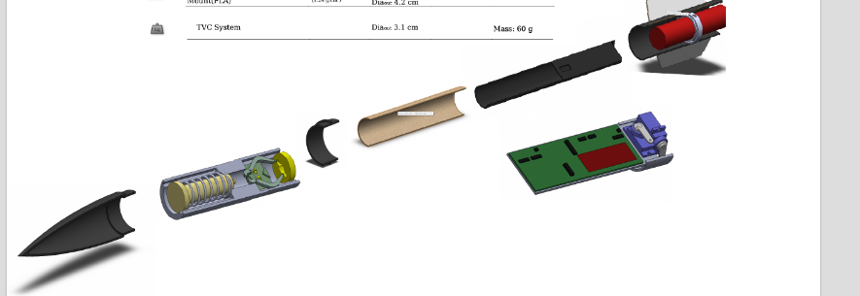
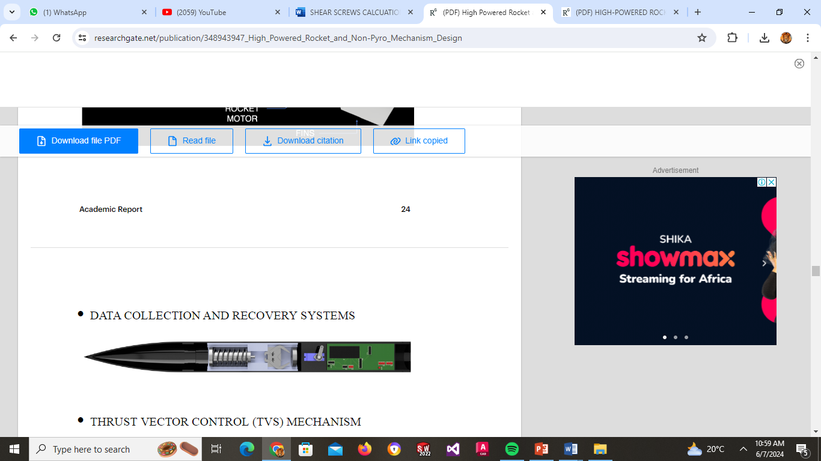
n
https://www.researchgate.net/publication/348943947_High_Powered_Rocket_and_Non-Pyro_Mechanism_Design

Slide 14
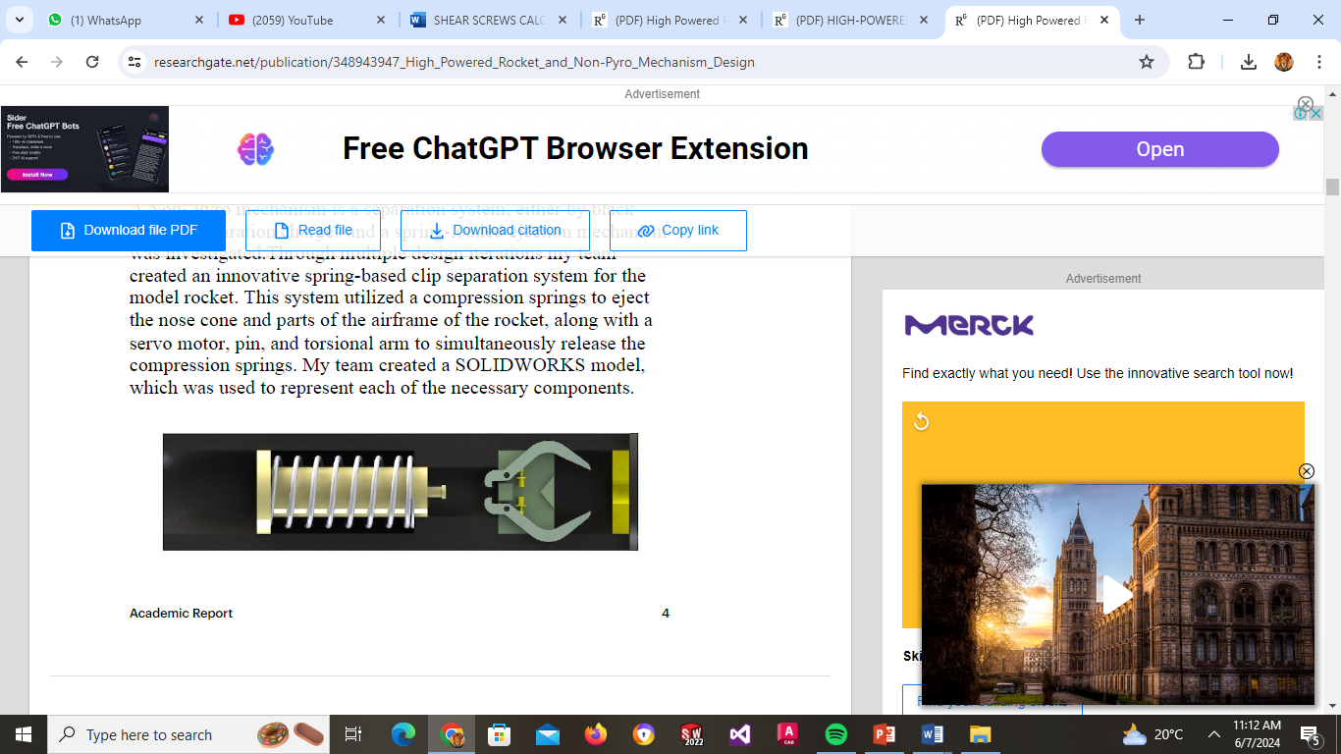

Slide 15
https://youtu.be/s1LHCBmNwHw?si=YjCvsQ2NKlQPyvi0

Slide 16
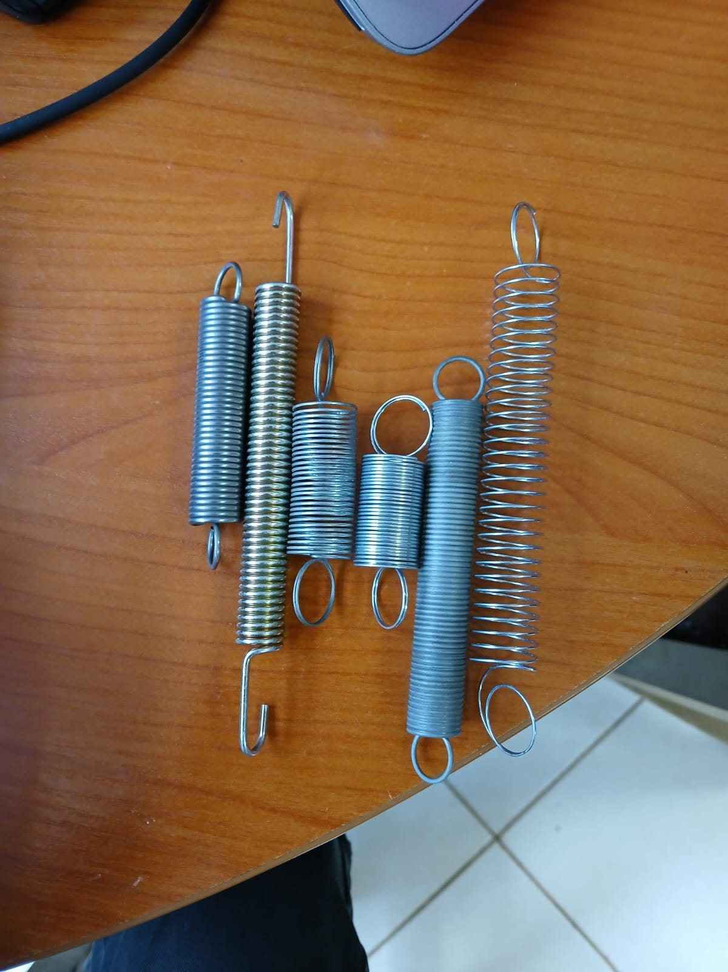
SAMPLE SPRINGS FROM LOCAL VENDOR

Slide 17
PYRO TECHNIQUE
BLACK POWDER
AKA GUN POWDER.
THREE MAIN COMPONENTS:
  SULFUR: ACTS AS A FUEL.
  CHARCOAL (MOSTLY CARBON): ALSO SERVES AS A FUEL.
  POTASSIUM NITRATE (SALTPETER): FUNCTIONS AS AN OXIDIZER.
GUNPOWDER IS CLASSIFIED AS A LOW EXPLOSIVE BECAUSE IT DEFLAGRATES (BURNS QUICKLY) RATHER THAN DETONATES.
CRIMSON POWDER
IT HAS ADVANTAGES OVER TRADITIONAL BLACK POWDER, INCLUDING A LOWER COMBUSTION TEMPERATURE (WHICH MINIMIZES HEAT DAMAGE TO THE ROCKET) AND HIGHER POTENCY.
CAN

Slide 18
CRIMSON POWDER
IT HAS ADVANTAGES OVER TRADITIONAL BLACK POWDER, INCLUDING A LOWER COMBUSTION TEMPERATURE (WHICH MINIMIZES HEAT DAMAGE TO THE ROCKET) AND HIGHER POTENCY.
EASILY AVAILABELE; CAN BE PREPARED EASILY
PROCEDURE FOR MAKING CRIMSON POWDER
HERE’S HOW TO MAKE IT:
INGREDIENTS:
6.2 GRAMS OF POTASSIUM NITRATE
4.5 GRAMS OF ASCORBIC ACID (FROM VITAMIN C TABLETS)
0.5 GRAM OF RED IRON OXIDE
30 ML OF BOILING WATER
PROCEDURE:
DISSOLVE THE INGREDIENTS IN BOILING WATER.
STRAIN TO REMOVE ANY CELLULOSE FILLER (IF USING VITAMIN C TABLETS).

Slide 19
BOIL UNTIL MOST OF THE WATER EVAPORATES, LEAVING A WET “PASTE.”
SPREAD THE PASTE ON AN ALUMINUM FOIL-LINED PAN.
DRY IN A PRE-HEATED OVEN AT 150°F (65°C) FOR ABOUT AN HOUR.
GRIND THE DRIED MIXTURE INTO A GRANULAR POWDER.
WARNING: THE DRY FORM IGNITES EASILY AND BURNS RAPIDLY. ALWAYS WEAR PROTECTIVE GEAR (FACE SHIELD, GLOVES) WHILE HANDLING. NEVER MAKE MORE THAN 10 GRAMS AT A TIME

Slide 20
CALCULATION FOR THE MASS OF BLACK POWDER
PSI BY AIRFRAME DIAMETER AND DESIRED FORCE
Aiframe Diameter | 100 Pounds | 150 Pounds | 200 Pounds | 250 Pounds
2.6” | 19 psi | 28 psi | 38 psi | 47 psi
4.0” | 8 psi | 12 psi | 16 psi | 20 psi
6.0” | 3.5 psi | 5.3 psi | 7.0 psi | 8.8 psi
7.5” | 2.3 psi | 3.4 psi | 4.5 psi | 5.7 p

